Slide 1
9.6 Feature Selection via Boosting

Slide 2
In this Section we discuss on popular way of performing feature selection, called boosting or forward stagewise selection.
Boosting is a 'bottom-up' approach to feature selection wherein we gradually build up our model one feature at a time by training a supervised learner, sequentially one weight at-a-time.
Doing this gives human interpreters an easier way to gauge the importance of individual features, and likewise lets them more easily derive insight about a particular phenomenon.

Slide 3
Boosting based feature selection

Slide 4
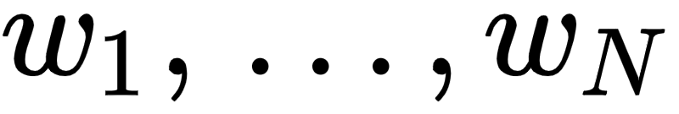
In tuning a model's weights one-at-a-time we of course do not want to tune them in any order, e.g., we do not want to just tune them at random, as this will not aid human interpretation.
Instead we want to tune them starting with the most important feature-touching weight (that is ), then tune the second most important feature-touching weight, then the third, and so forth.
Here by 'importance' we mean how each input feature contributes to the final supervised learning model as determined by its associated weight...
...or in other words how each contributes to minimizing the corresponding cost as much as possible.

Slide 5



Now at the start of the weight learning process we begin with just the bias.
That is we begin with a model - which we will denote as - that consists of the bias alone

Slide 6
To begin we first tune the bias parameter by minimizing an appropriate cost over this variable alone.
For example, if we are performing regression employing the Least Squares cost and we minimize

Slide 7


This gives the optimal value for our bias . Thus our starting model is now

Slide 8
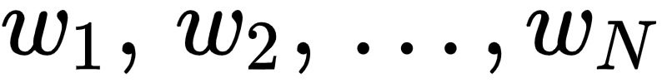
Next, at the first round of boosting, in order to determine the most important feature-touching weight we try out each one...
...by minimizing a cost over each one individually having already set the bias optimally.
That is we minimize N cost functions over a single feature-touching weight alone.

Slide 9

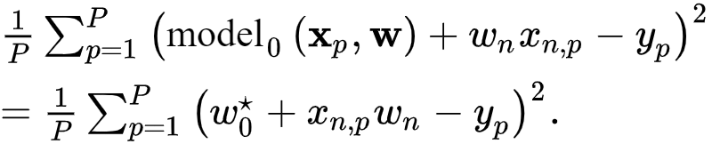

So e.g., in the case of Least Squares regression the of these subproblems takes the form
Again, the bias weight has already been set optimally and is not tuned in each subproblem above - we only tune the weight .

Slide 10

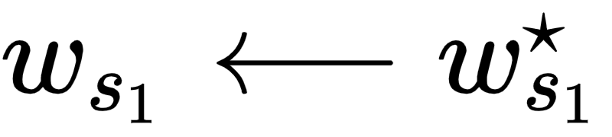
The weight that produces the smallest value is the one that helps best explain the relationship between the input and output of our dataset.
It is therefore most important feature-touching weight we learn.
Denoting this weight as , we then fix it at its optimally determined value (discarding all other weights tuned in each of these subproblems).

Slide 11

We update our `model` accordingly.
We call our updated `model` which is a sum of our optimal bias and this newly determined optimal feature-touching weight

Slide 12
At the second round of boosting we determine the second most important feature-touching weight.
To do this we then sweep through the remaining N-1 weights (i.e., excluding and which we have already tuned).
We try out each one individually by minimizing a cost over each weight independently.

Slide 13
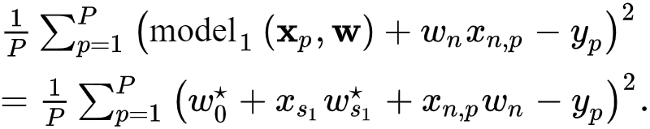


In the case of Least Squares regression such cost looks like
Again with each of these subproblems and have already been set optimally, we only tune the weight in each instance.

Slide 14
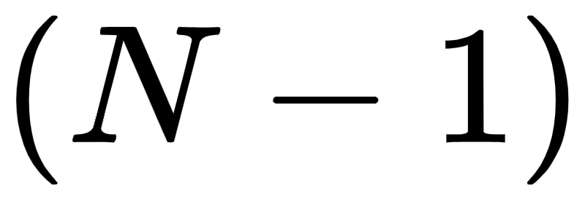
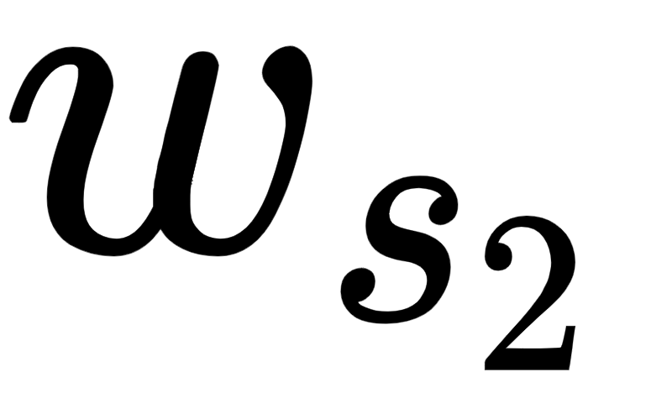
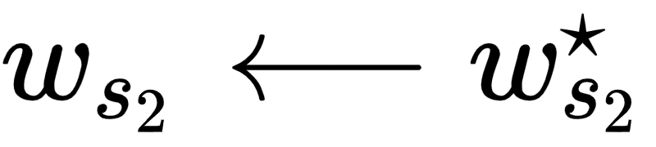

The weight producing the smallest value from these subproblems tells us the second most important feature.
Denoting the cost minimizing weight , we then fix the value of this weight at its optimally determined value
Updating our model accordingly, calling it , we have

Slide 15


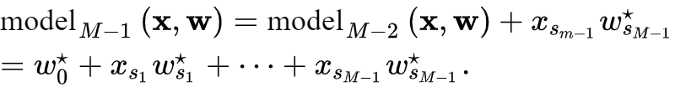

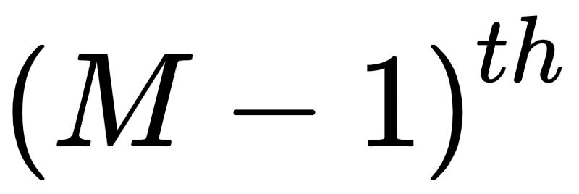
More generally, at the round of boosting, to determine the most important feature-touching weight we follow the same pattern.
When we do this we have already determined the optimal setting of our bias and the top most important feature-touching weights, our model taking the form
Here denotes our optimally tuned most important feature-touching weight.

Slide 16
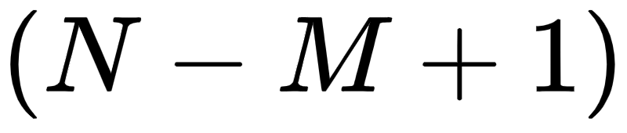
We then must setup and solve subproblems, one for each feature-touching weight we have not yet resolved.
For example, in the case of Least Squares regression the of these takes the form
Here again in each case we only tune the individual weight .

Slide 17

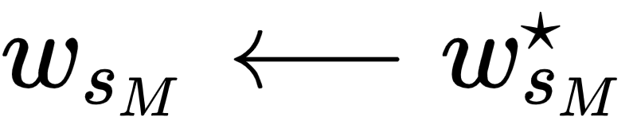
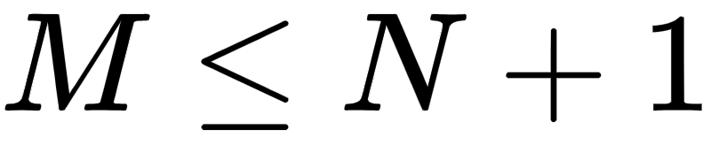

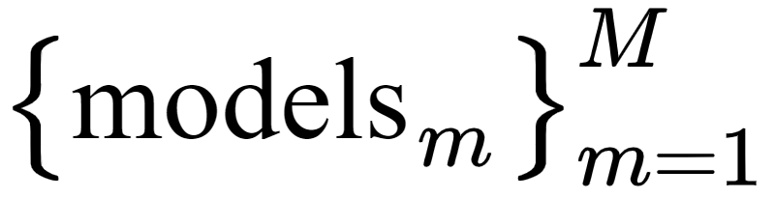
Denoting this weight we then fix its optimal value and add its contribution to the running model as
Given that we have N input features we can continue until .
Note too how in building we have constructed a sequence of models .

Slide 18
This method of model building (via the construction of a simpler series of models) adding one feature at-a-time...
...and tuning only the parameters of the feature added keeping all others fixed at their previously tuned values...
...is referred to as boosting, or similarly as forward stage-wise selection.

Slide 19
Because we are trying to determine the importance of each input feature here that before we begin the process of boosting we always need to standard normalize the input to our dataset as detailed in [Section 9.3]
By normalizing each input feature distribution we can fairly compare each input feature's contribution and determine the importance of each.

Slide 20
How many features should be selected?

Slide 21
Because feature selection is done for the purposes of human interpretation the number of features M to select can be based on several factors.
A benchmark value for M can be hand chosen based on the desire to explore a dataset, and the procedure halted once this number of rounds have completed.
One can also halt exploration when adding additional features to the model results in very little decrease in the cost, as most of the correlation between inputs and outputs has already been explained.

Slide 22
Finally, M can be chosen entirely based on the sample statistics of the dataset via a procedure known as cross-validation.

Slide 23
Example: Exploring features for predicting housing prices via boosted regression

Slide 24
Below we show the results of running the boosting procedure detailed above - using a Least Squares cost and Newton's method optimizer.
Here we use the Boston Housing dataset. This dataset consists of a set of basic statistics on 506 homes in the city of Boston in the US.
The input statistics are to be used to predict the median value of each car.

Slide 25
The N=13 dimensional input features include: per capita crime rate by town (feature 1), average number of rooms per dwelling (feature 6), weighted distances to five Boston employment centers (feature 8), and the percentage of the local population deemed 'lower class' (denoted LSTAT, feature 13).

Slide 26
The result of running M=5 rounds of boosting is visualized in the top panel below.
This special kind of cost function history was used in the prior example, and in this plot each weight / feature added to the model at each round of boosting is shown along the horizontal axis (starting with the bias which has index 0).

Slide 27
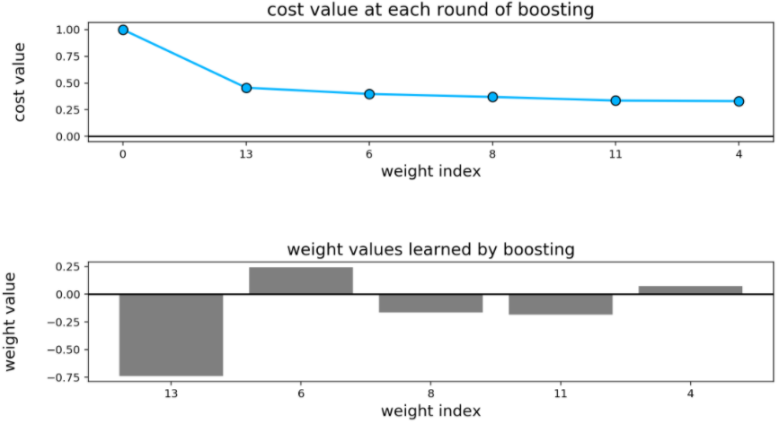

Slide 28
As we can see, the first two features found via boosting that most correlate with the output are LSTAT (the top feature, number 13) and the average number of rooms per dwelling (the second most important feature, number 6).
Examining the histogram of model weights in the bottom panel, we can see that unsurprisingly the LSTAT value is highly negatively correlated with the output (median home value) while the average number of rooms feature is positively correlated with the output.

Slide 29
Example: Exploring features for classifying credit risk of loan applicants via boosting

Slide 30
Below we show the results of running the boosting procedure detailed above - using a Softmax cost and Newton's method optimizer - and a slightly adjusted version of the *German Credit* dataset.
This is a two-class classification dataset consisting of 1000 samples, each a set of statistics extracted from loan application to a German bank.

Slide 31
Each input then has an associated label - either a 'good' or 'bad' credit risk as determined by financial professionals. In constructing a learned classifier for this dataset we create an automatic credit risk assessment tool that can help decide whether or not future applicants are good candidates for loans.

Slide 32
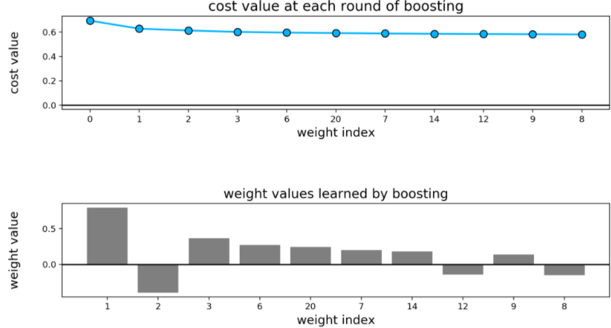

Slide 33
The N=20 dimensional input features includes features like: the individual's current account balance with the bank (feature 1), the duration (in months) of previous credit with the bank (feature 2), the payment status of any prior credit taken out with the bank (feature 3), the amount of credit currently had with the bank (feature 4), and the current value of their Savings/Stocks (feature 6). These are precisely the top five features found via boosting. As we can see in the bottom panel, unsurprisingly most of these top features are positively correlated with an individual being a 'good' or 'bad' credit risk.

Slide 34
Boosting is an efficient scheme

Slide 35
The boosting idea detailed above is a greedy algorithm...
...meaning that at each stage we choose the next most important feature-touching weight and tune it properly by literally trying out all remaining feature-touching weights by solving a set of respective subproblems...
not by leveraging some abstract mathematical criterion.

Slide 36
While each round of boosting demands we solve a number of subproblems, each one is a minimization with respect to only a single weight and is therefore very easy to solve virtually regardless of the local optimization scheme used.
This makes boosting a computationally effective approach to feature selection, and allows it to scale to datasets with large N.
A weakness inherent in doing this - that is in determining one feature-touching weight at a time - is that interactions between features / feature-touching weights can be potentially missed.

Slide 37
To capture potentially missed interactions between groups of features / weights one might naturally extend the boosting idea and try to add a group of R feature-touching weights at each round instead of just one weight.
However a quick calculation shows that this idea would quickly fail to scale. In order to determine the first best group of R feature-touching weights at the the first stage of this approach we would need to try out every combination of R weights by solving a subproblem for each.

Slide 38
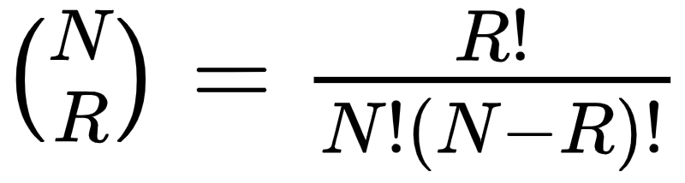
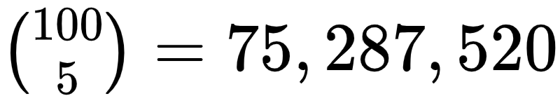
The problem is that there are combinatorially many subgroups of size R.
More precisely there are subproblems, and thus equally many subproblems to solve (this is far too many problems to solve in practice e.g., ).

